Slide 1
Power BI - EDGE Session
Anusha Ananth
6/5/2023

Slide 2
AGENDA
Introduction to Power BI
Desktop & Service
Connect to Data
Transform Data using Power Query
Create Visualizations, Pages and Reports.
Share, Export, Collaborate, Schedule and Subscribe
Security Aspects in Power BI
Embedding Power Apps in Power BI
Recap

Slide 3
Introduction to Power BI
Power BI (Reference) is a collection of software services, apps, and connectors that work together to turn your unrelated sources of data into coherent, visually immersive, and interactive insights.
Power BI consists of several elements that all work together, starting with these three basics:
A Windows desktop application called Power BI Desktop. Download link.
An online software as a service (SaaS) service called the Power BI service.
Power BI Mobile apps for Windows, iOS, and Android devices.
Beyond those three, Power BI also features two other elements:
Power BI Report Builder, for creating paginated reports to share in the Power BI service.
Power BI Report Server, an on-premises report server where you can publish your Power BI reports, after creating them in Power BI Desktop.
Licenses (Reference)
Power BI per-user licenses:
Free
Pro
Premium Per User (PPU).
Premium capacity-based license
PPU and Pro users with access to a Power BI Premium capacity-based license, can create content in workspaces that are assigned to Premium capacity. PPU and Pro users can then grant colleagues, including free users, access to those Premium workspaces.

Slide 4
Introduction to Power BI
Feature | Name | Description | Comments
Elements | Power BI Service | Cloud application to view and create reports on web
 | Power BI Desktop | Desktop application to create, view datasources and reports
 | Power BI Mobile | mobile apps for Windows, iOS, and Android devices
 | Power BI Report Builder | for creating paginated reports to share in the Power BI service
 | Power BI Report Server | on-premises report server where you can publish your Power BI reports, after creating them in Power BI Desktop
Licenses | Free | Desktop access for creating dashboards but can't be shared/published via service
 | Pro | Access to publish and share through service with other Pro users
 | Premium Per User | Access to publish and share through service with any user, with some more additional features on capacity and exports
 | Premium Capacity Workspace | Workspace is built with Premium capacity, allowing all users of the Environment to have Premium capacity
Components | Dashboard | Cloud only feature to create Dashboards by pinning the various Reports into a common view | Desktop and Cloud
 | Reports | Collection of one or more Pages containing one or more visualizations | Desktop and Cloud
 | Datasets | Live/Extract connection to the source data | Create on Desktop only
 | Paginated Reports | Live/Extract connection to the source data | Report Builder and Cloud

Slide 5
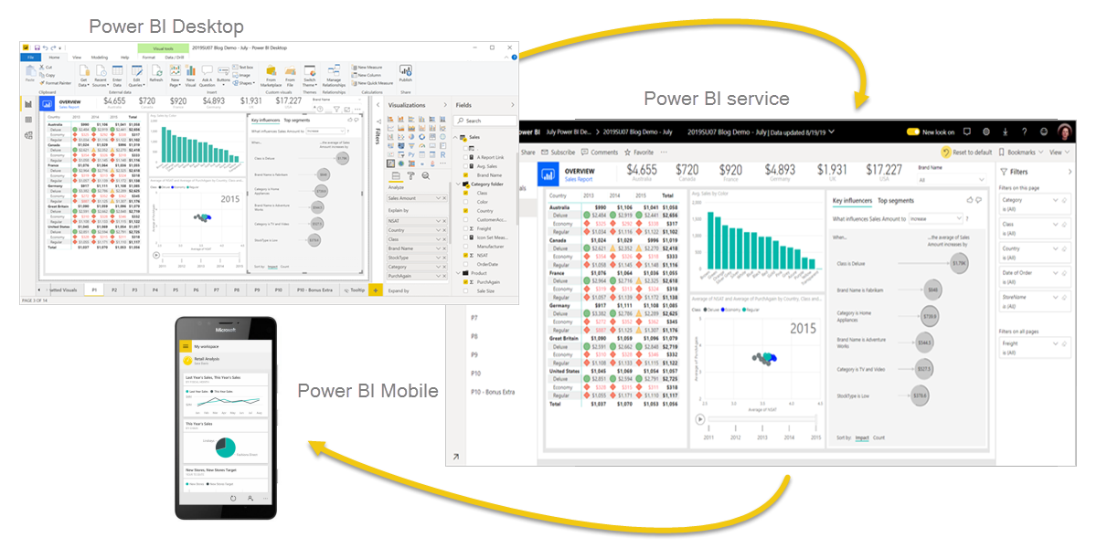
Introduction to Power BI
Power BI (Reference)
collection of software services, apps, and connectors that work together to turn your unrelated sources of data into coherent, visually immersive, and interactive insights.
Power BI Desktop (Download Link)
Desktop application to create, view datasources and reports
Power BI Service (Login Link)
Power BI Web application that can be accessed by logging in to a Web browser.
Power BI Mobile
Power BI Mobile apps for Windows, iOS, and Android devices.

Slide 6
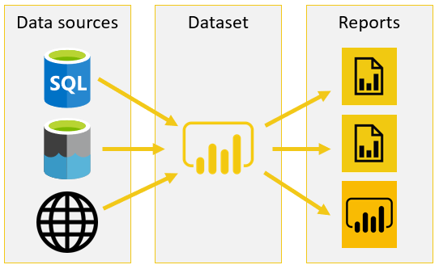
Introduction to Power BI
Service
Workspace1
Report1
- Dataset1
Report2
-Dataset2
Workspace2
Report3
-Dataset1
Page1
Page2
Viz1
Viz2
Page1
Viz1
Workspace
Containers for dashboards, reports, and datasets in Power BI. Users can collaborate on the content in any workspace except My workspace.
Report
A multi-perspective view into a single dataset, with visualizations that represent different findings and insights from that dataset. Can have a single visualization or many, a single page or many pages.
Page
Reports have one or more pages. Each tab on the report canvas represents a page.
Visual/Visualization/Viz
A table or a chart used for analysis. Some visuals are bar chart, treemap, doughnut chart, map.
Dataset
A dataset is a collection of data used to create visualizations and reports.
Power Query Editor (Reference)
Power Query user interface, where you can add or modify queries, manage queries by grouping or adding descriptions to query steps, or visualize your queries and their structure with different views.
M-Code (Reference)
Data Mash-up code used to filter and combine, i.e., to mash-up data from one or more of a rich collection of supported data sources.
DAX Query (Reference)
Data Analysis Expressions (DAX) is a formula expression language used in Analysis Services, Power BI, and Power Pivot in Excel.

Slide 7
Desktop & Service
Most common uses for Power BI Desktop (Reference) are as follows:
Connect to data. Reference
Transform and clean data to create a data model. Reference
Create visuals, such as charts or graphs that provide visual representations of the data.
Create reports that are collections of visuals on one or more report pages. Reference
Secured and Trusted Data with Row Level Security and Object Level Security
Most common uses for Power BI Service (Reference) are as follows:
Exploring Power BI Service and Create reports. Reference
Share reports with others by using the Power BI service. Reference
Scheduling. Reference
Subscription. Reference
Secured and Trusted Data with Content Access

Slide 8
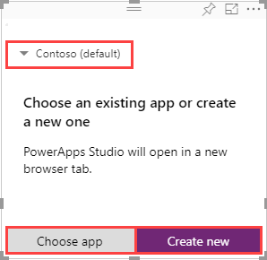
Embedding Power Apps in Power BI
Steps required to use the Power Apps visual in your Power BI report. (Reference)
Power Apps visual is available by default in the Power BI service. If you're using Power BI Desktop and don't see it, you must upgrade to the latest version of Power BI Desktop.
Add the Power Apps visual to your report and set the data fields associated with it.
You can choose an existing app or create one, but the report must be published to the Power BI service and opened in Microsoft Edge or Google Chrome.
If you choose to create an app, you can choose in which environment to create it.
After you have completed building or making changes to your app, save and publish the app in Power Apps to see your app in the Power BI report.
Once you're satisfied with your changes, make sure to share the Power Apps app with users of your report and then save your report.
You've created a report in which your users can take actions as they gain insights from your data.

Slide 9
Security Aspects in Power BI
Power BI Security (Reference) for Secured access and Trusted Data
Data - Row Level Security (Reference) & Object Level Security (Reference)
Desktop to create Roles
Service to assign Users and user groups
OLS can’t have native definitions in Power BI. Microsoft suggests using External Tools like “Tabular Editor”
Content – Access based Security
Workspace
Report
Dataset
Report and Page access control through App
Data Privacy of Dataset
Limitation - Imported Data is visible to the user though the users have a restriction on the source data in below scenarios
PBIX file is shared as file from Desktop
Power BI imported on PowerPoint for a live demo

Slide 10
Recap
Power BI Elements – Desktop, Service
Connect to Data and create visualizations and reports
Transform Data using Power Query
Create Columns and Measures using DAX
Create Visualizations with options of filters, drill-up/down
Create Roles for Row Level security & a brief introduction to Object Level security
Adding more Datasources and Modelling for analysis
Publish to Workspace for viewing the report on Service
Navigating Service and Report options of Share/Collaborate/subscribe apart from the options on Desktop
Embed Power App to Power BI
Multiple layers of Security

Slide 11
Additional links for Power BI Service
Sign-in
Explore Power BI as a Business users
Sorting a Report
Filters in a report
Slicers in a report
Drill mode
Collaborating on reports with user comments
Integrating reports into Team meetings
Exploring Power BI Web (official term – service)
Explore Power BI Home
Explore Reports
Features as free user
Copying a visual into other application

